Slide 1

Comparative Cost-Effectiveness Analysis of Two HPV Vaccines: Gardasil 9 vs. Cervarix
Xuan(Ophelia) Jiang
May 6th 2025

Slide 2

Contents
Background
Motivation
Methods
HPV
HPV Vaccines
Decision Analysis
CEA
QALY
ICER
Cohort Simulation
Data Collection
Results
Discussion
Transition Probability
Costs
QALY
ICER
CEA Plot
Advantages
Limitations
Future Direction

Slide 3

Background

Slide 4

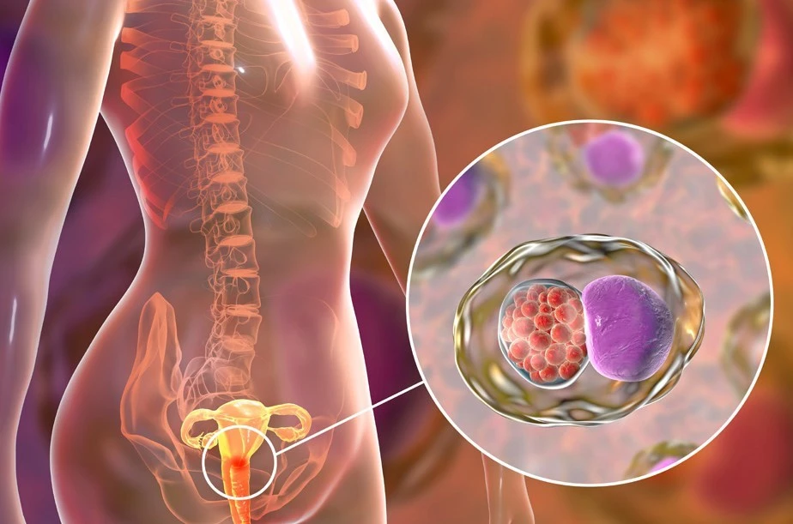
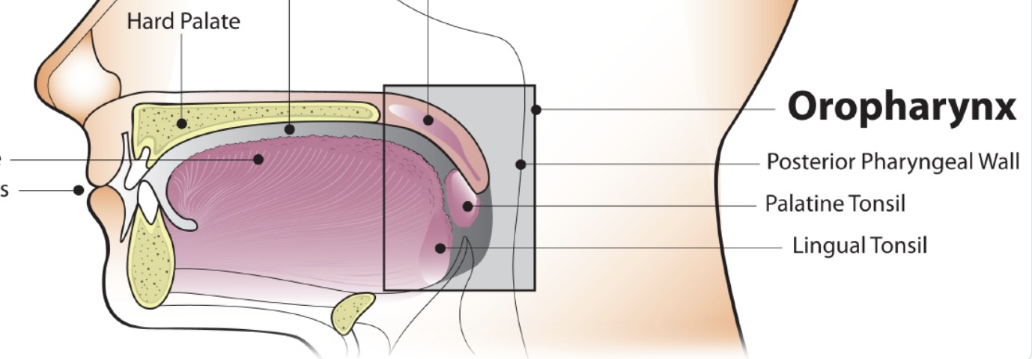
Human Papillomavirus (HPV)
Group of over 200 non-enveloped DNA viruses
Symptoms depend on the type of epithelial cells infected
Low-risk types: HPV-6 and HPV-11 (mostly cause warts)
High-risk types: HPV-16 and HPV-18 (linked to cancers)
CDC: ~13 million new HPV infections in the U.S. each year

Slide 5
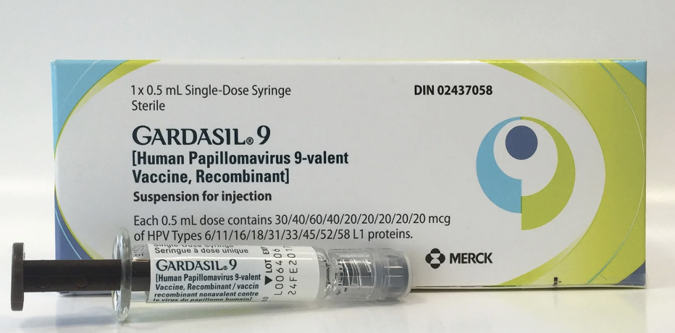
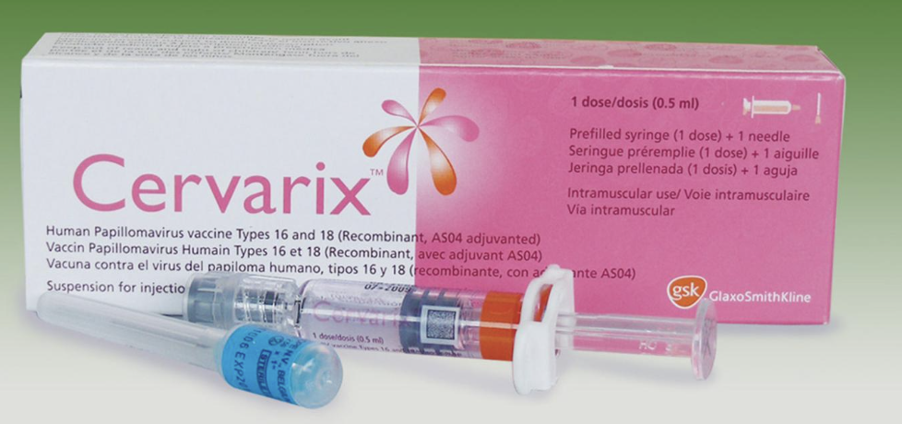
HPV Vaccines
Gardasil 9
Use VLPs to stimulate immune response
Broad protection against multiple high-risk HPV types and genital warts
Higher cost compared to other vaccines
Cervarix
Use VLPs to stimulate immune response
Targets only HPV types 16 and 18 (linked to 70% of cervical cancers)
More cost-effective and requires only two doses

Slide 6
Cost- Effective Analysis
Purpose:
Quantifies the trade-off between healthcare costs and long-term health outcomes
Approach:
Provides a structured method to compare alternative interventions
Key Metrics:
QALYs (Quality-Adjusted Life Years) to measure health benefits
ICER (Incremental Cost-Effectiveness Ratio) to assess economic efficiency
Importance:
Guides decision-making under constrained healthcare budgets
Methodology:
Uses simulation modeling to project disease progression, healthcare costs, and quality of life over time, especially when direct long-term data are lacking

Slide 7
Motivation
Prior Studies: Idealized trial data
My Project: real-world U.S. population dynamics
Timely reassessment
Notes:
.

Slide 8

Methods
Make Educated Decisions
Cost Effectiveness Analysis
Cohort Simulation Model

Slide 9
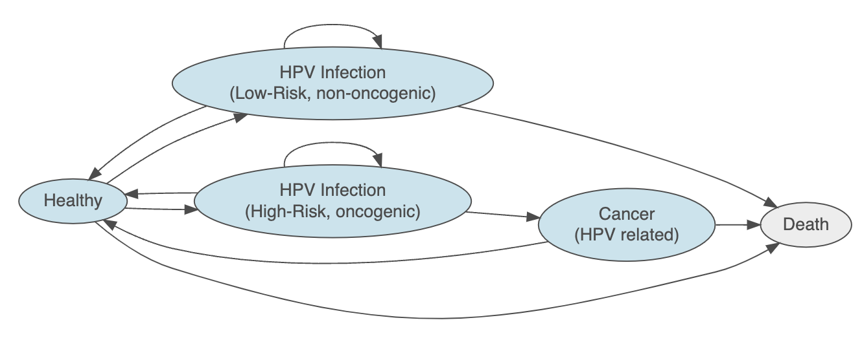
Overview - Markov State Diagram

Slide 10
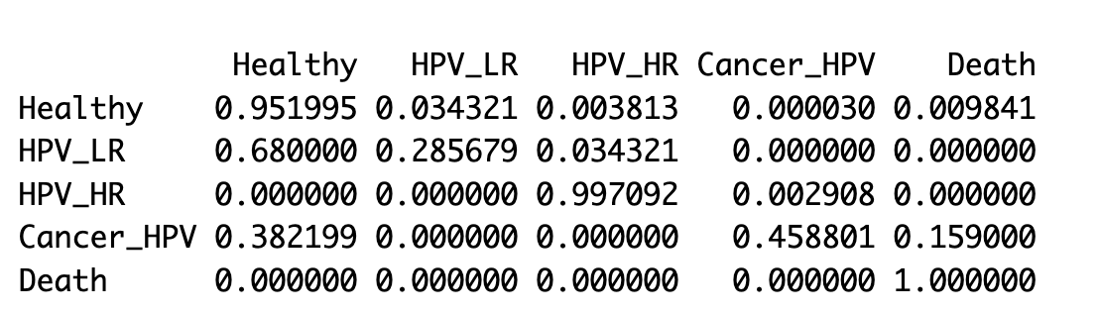
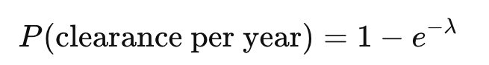
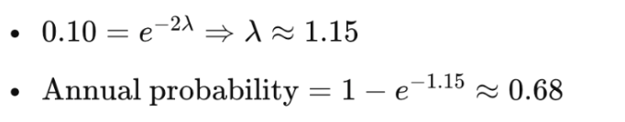
Transition Probability Matrices
No Vaccination
https://www.cdc.gov/hpv/about/index.html
How do I get the transition probabilities? …… Long Story🚬🚬🚬
Example 1
Healthy → HPV (all types) : 13 million / 334.9million (us 2023 yearly new infection) 0.0388
Healthy → High-Risk HPV : 10% of HPV cases
Example 2
HPV LR → Healthy: 90% clear in 2 years → exponential decay 0.68

Slide 11

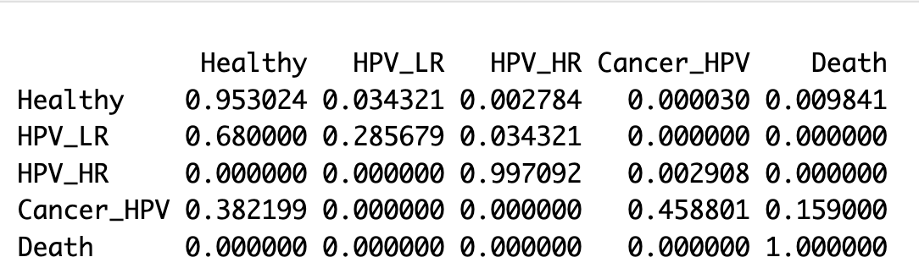
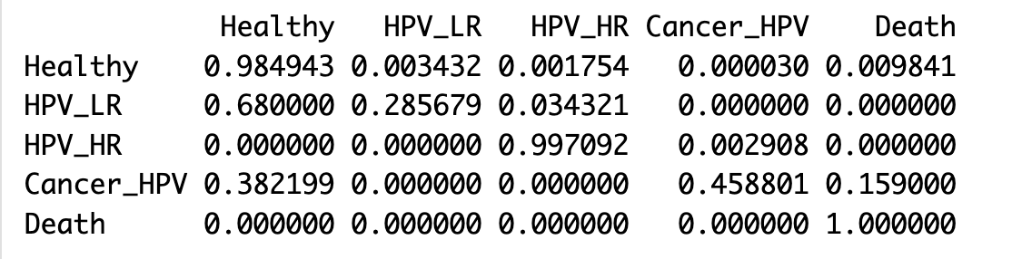
Transition Probability Matrices
Cervarix Vaccination
Gardasil 9 Vaccination
Neither Cervarix nor Gardasil 9 prevents the progression from high-risk HPV (HPV_HR) to cancer once the high-risk infection is already acquired.
HPV vaccines are prophylactic, not therapeutic.

Slide 12
Cohort Simulation - Model Assumptions
Cohort: 100,000 individuals
Homogeneous cohort with respect to key risk factors (age, sex, exposure, etc.)
For vaccinated cohorts, all individuals received the full recommended doses of the vaccine
Discrete, one-year cycles
Prediction Period: 50 years
Transition probabilities remain constant over time
Why do I use cohort simulation model?
Cohort simulation model offers a structured, transparent, and scalable way to project long-term health and economic outcomes for a defined population over time, especially when real-world longitudinal data is unavailable.
Notes:
explain why 100, 000 is used

Slide 13
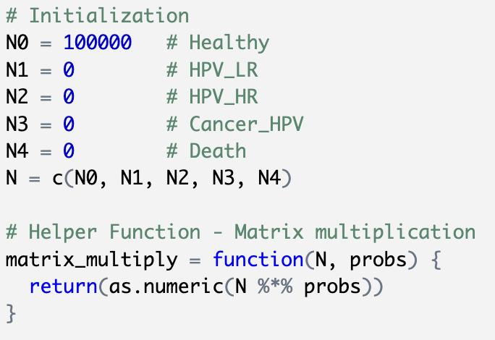
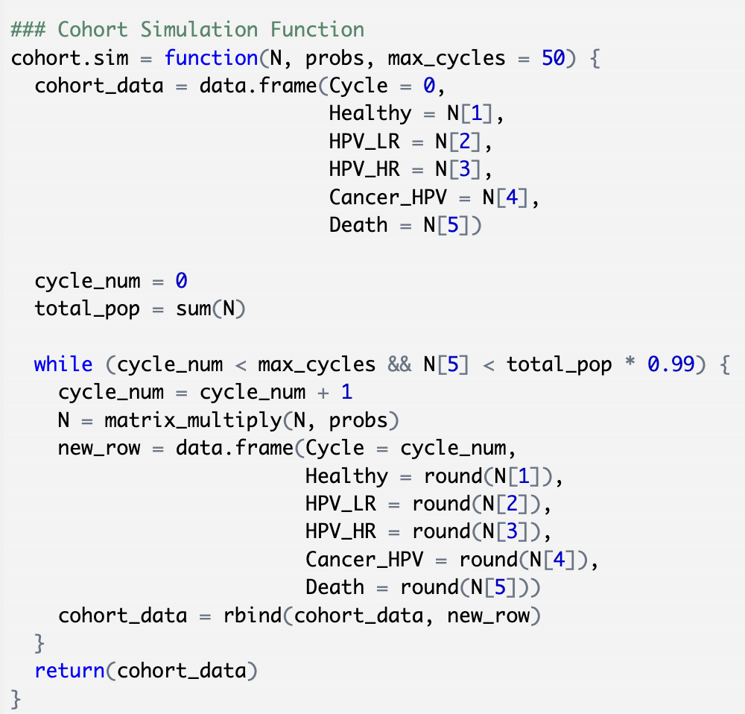
Cohort Simulation
Population distribution across health states for each year.

Slide 14
Quality-Adjusted Life Years - QALYs
1. Track Health State Distribution Over Time
cohort.sim() function return a data frame that record the number of individuals in each state at each cycle
2. Apply Utility Weights (data gathered from literature)
Utility reflect how desirable (or impaired) each health condition is
3. Calculate Total QALYs Per Cycle
Multiplying the number of individuals in each state by its utility weight, summing across all states.
4. Normalize by Population Size
Divided by the cohort size
5. Apply Discounting
Health benefits are valued less in the future, 3% annual discount rate
6. Aggregate Over Time
Summed the discounted QALYs over all cycles to obtain the health outcome for each strategy
Total discounted QALYs per person for each type of vaccine

Slide 15
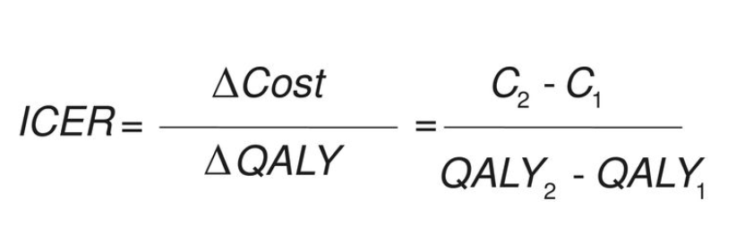
Incremental Cost-Effectiveness Ratio (ICER)
Public Health Dollars
ICER captures the trade-off between additional cost and additional health benefit
Public health budgets are limited. ICER helps prioritize interventions that provide the most health for the limited money.
Standardized way, can be compared with established thresholds

Slide 16
Sensitivity Analysis
One-Way Sensitivity Analysis on
Healthy → HPV_HR
Healthy → HPV_LR
HPV_HR → Cancer
Initial guess: HPV_HR → Cancer
Since both Gardasil 9 and Cervarix are prophylactic rather than therapeutic, they do not influence this progression once high-risk HPV infection has already occurred.

Slide 17

Results
QALY
Total Cost
ICER
CEA Plane

Slide 18
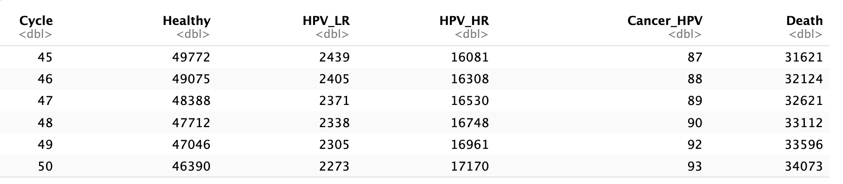
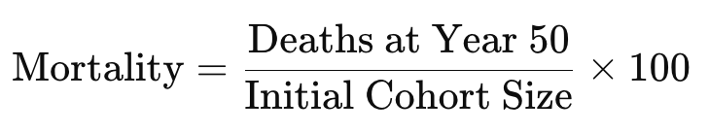
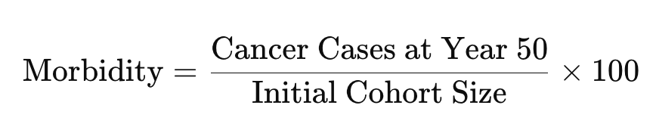
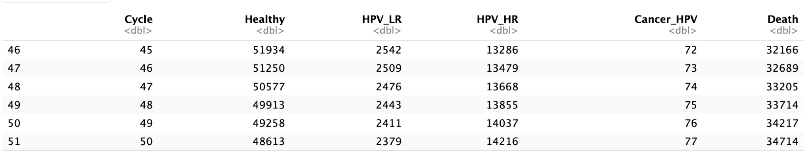
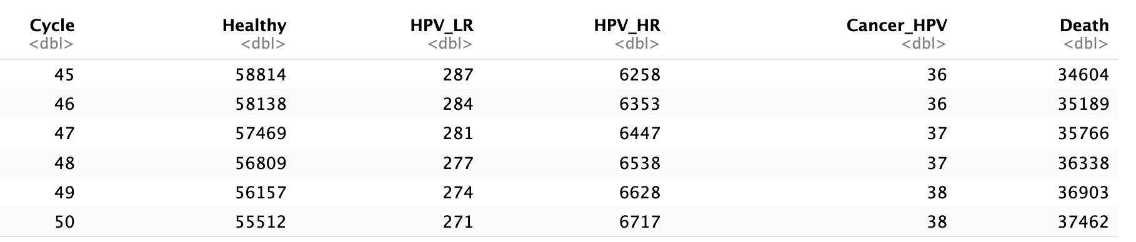
Cohort Simulation Result Dataframe
tail(cohort_none)
tail(cohort_cervarix)
tail(cohort_gardasil)
Mortality (%)
Morbidity (%)
Vaccine | Mortality | Morbidity
None | 34.073 | 0.093
Cervarix | 34.714 | 0.077
Gardasil 9 | 37.462 | 0.038
Notes:
- consider the morbidity as LR/Total

Slide 19
Result Table
Vaccines | QALYs (Discounted) | Vaccine Costs | Total Costs (Discounted) | ICER
None | 22.54 | $0 | $718.51 | Cervarix vs None: $ -27984.01 Gardasil vs None: $ -5679.38
Cervarix | 22.53 | $200 | $896.64 | Gardasil vs Cervarix: $ -4425.31
Gardasil 9 | 22.42 | $771.213 | $1397.64 | Gardasil vs Cervarix: $ -4425.31

Slide 20
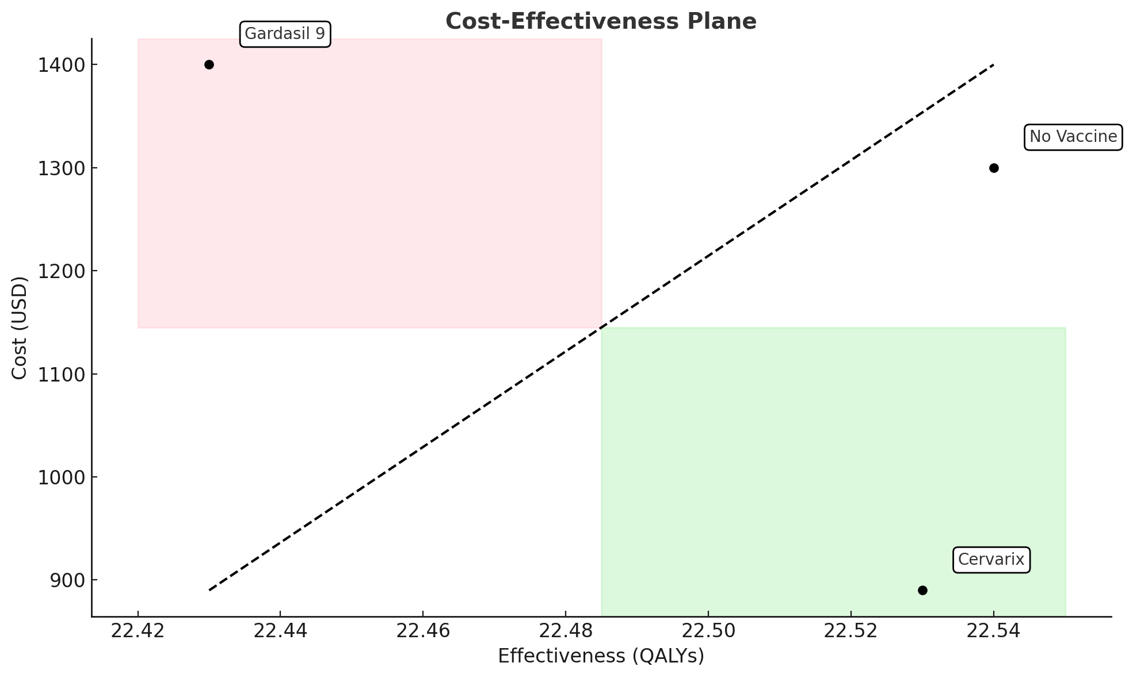

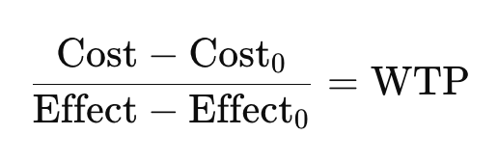
Cost-Effectiveness Analysis Plane
•Dominant intervention :
most effective and least costly
• Dominated intervention:
least effective and most costly
Dominated
Diagonal Line →
Willingness to Pay Threshold (WTP)
Set to 50,000 per QALY (based on literature)
Diagonal Line Formula→
Dominant

Slide 21
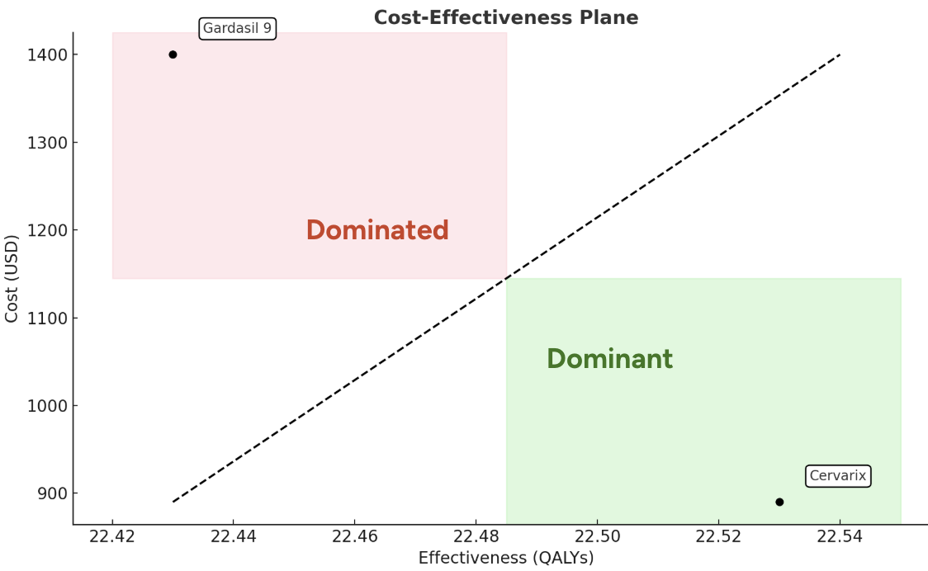
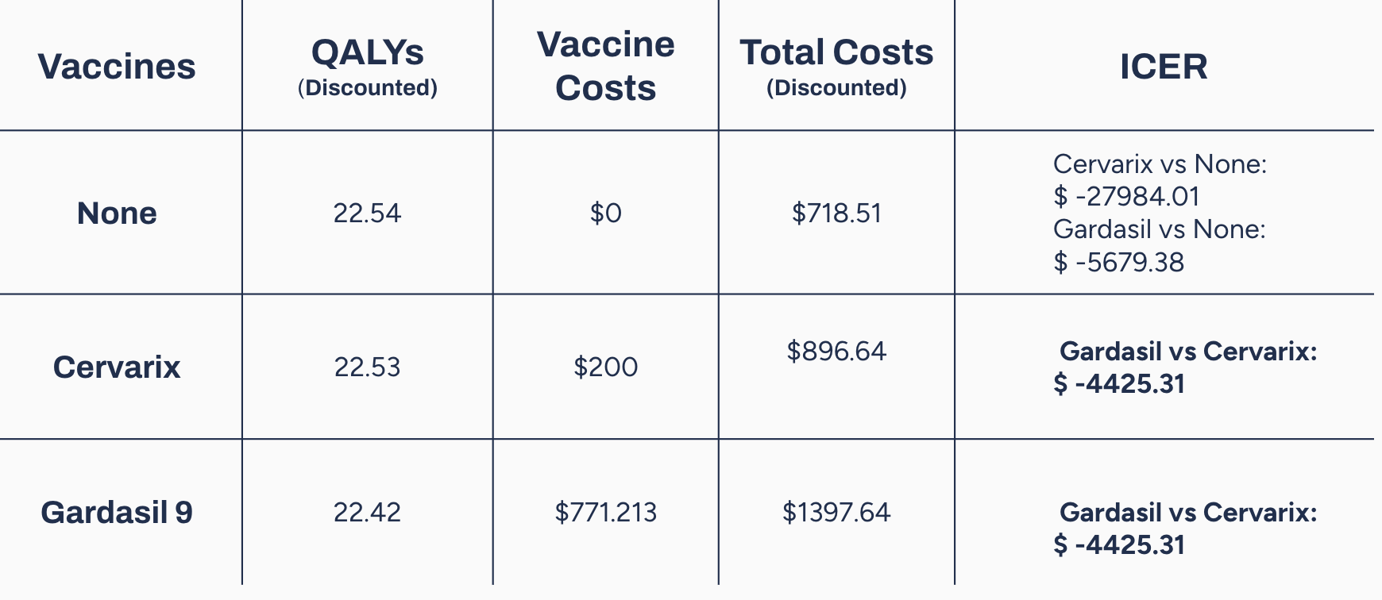
Results Summary
Comparing with no-vaccine cohort
Cervarix and Gardasil 9 both show higher total costs and lower QALYs compared to the no-vaccine cohort, resulting negative ICERs.
Comparing two vaccines
Cervarix has a better ICER than Gardasil 9, indicating relatively greater cost-effectiveness between the two vaccines.
Gardasil 9 shows the lowest morbidity (0.038%), indicating better cancer prevention.
These findings are counterintuitive, given the known public health benefits of HPV vaccination.

Slide 22
Discussion
Mixed Population for “no vaccine” Cohort
The transition probabilities for the “no vaccine” group were sourced from CDC surveillance data, which includes the general population. → “no vaccine” cohort actually composed of individuals who have received different types of HPV vaccines and individuals who have never received HPV vaccines.
→ Therefore, comparisons involving the no-vaccine group may be biased and not representative of a true unvaccinated baseline.
However, since Cervarix and Gardasil 9 were evaluated under the same model assumptions, their comparative results are still valid.
→ Under the model, Cervarix appears more cost-effective than Gardasil 9 in a relative sense.

Slide 23
Acknowledgement
Thanks for Listening !
Thank you Professor and my supportive classmates!

